Slide 1

ASSIGNMENT AUTHOR PORTFOLIO WEBSITE
Anush Priya T
Department of Computer Science and Engineering

Slide 2
PROBLEM STATEMENT
Develop an AEM website with the following requirements:
Header: Use OOTB Header component with links to Home, Books (dropdown), About Me, and Contact Me.
Footer: Use text or list components for About Me, Contact Me, Books List (open in new tab), and Social Media links.
Home Page: Use OOTB Content Page template with a Teaser component for an award ceremony and 5-6 content components.
Books Page: Use a custom Book Page template. Create book pages under
About Me Page: Use the custom Author Component.
Contact Me Page: Use text or teaser components for contact details and social media links.
Template Configuration: Add header and footer at the template level for consistency.

Slide 3
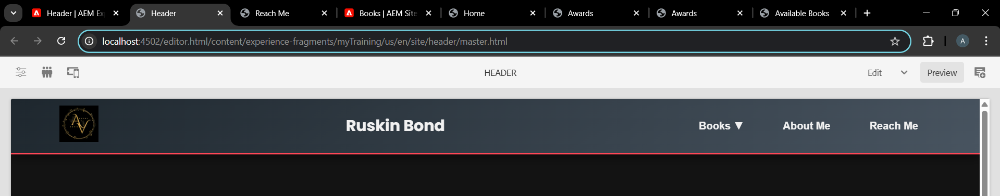
HEADER
AEM Experience Fragment showcasing the Header section with a logo, site title ("Ruskin Bond"), and navigation links for seamless user navigation.

Slide 4
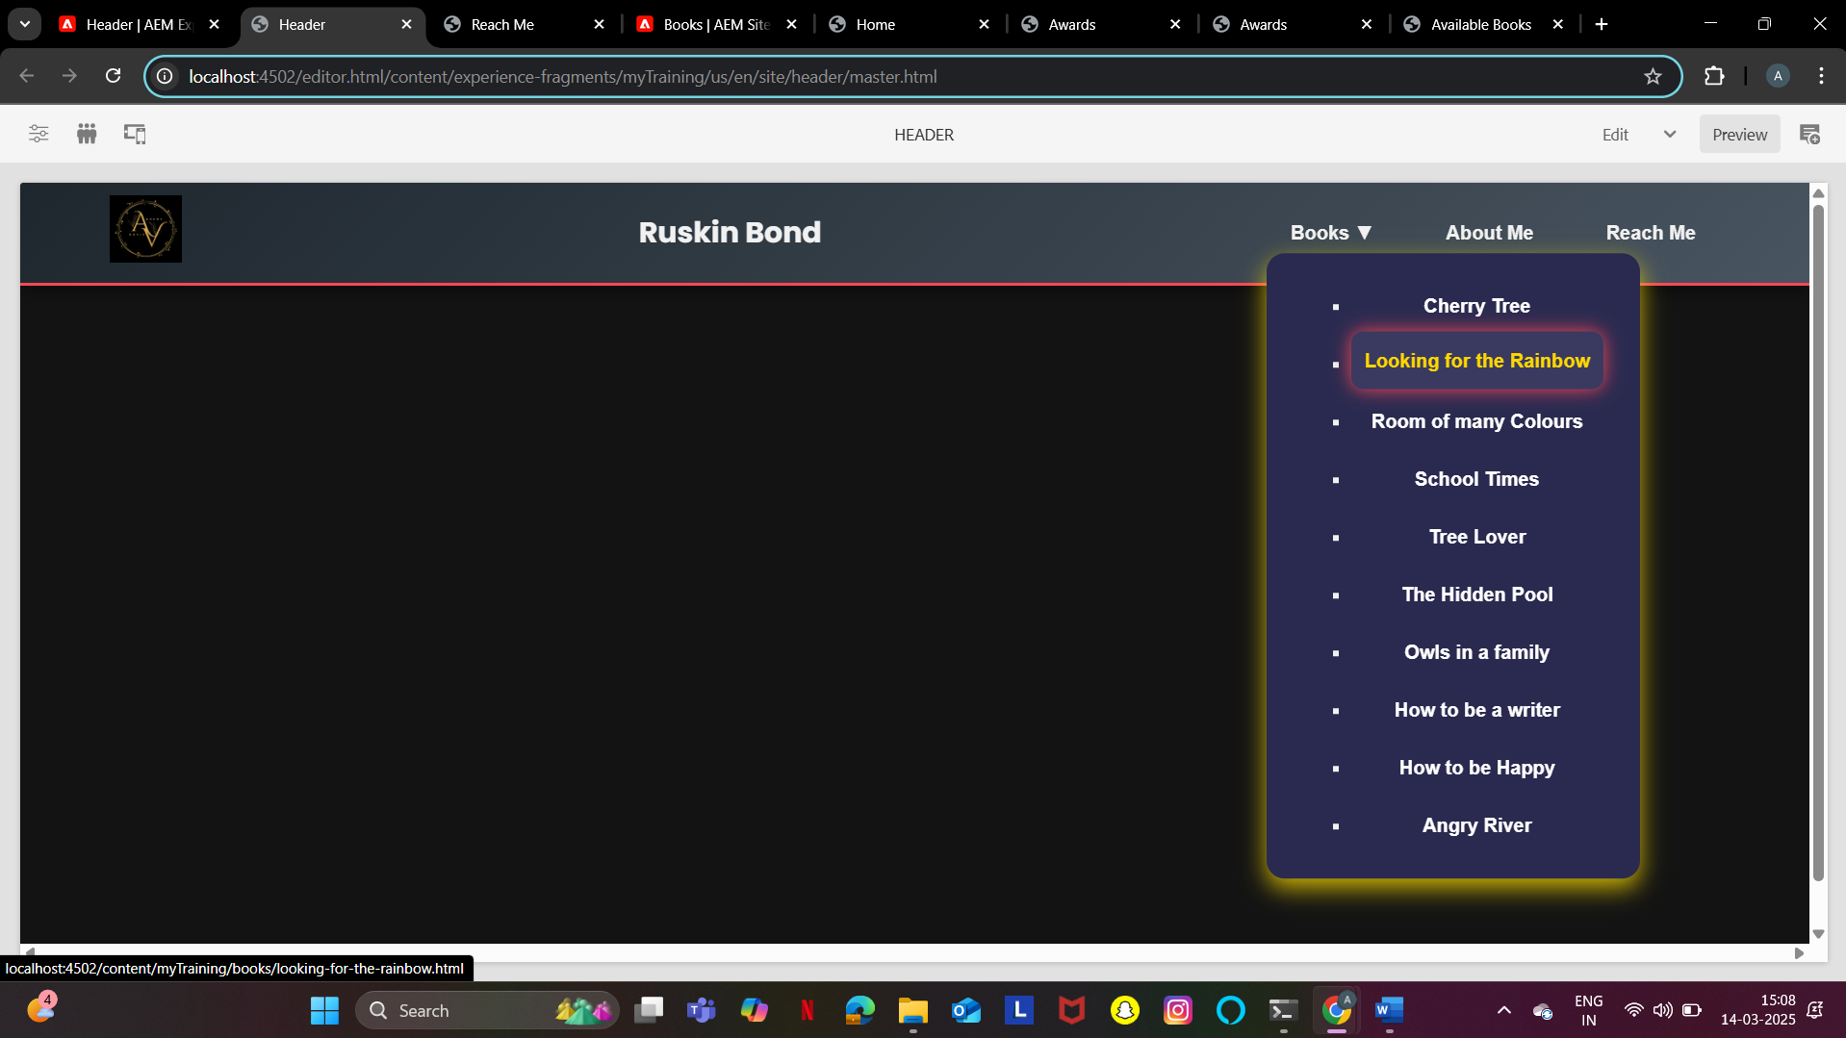
Here if we click the book name it’ll get navigated to the respective book page , and the same for about me and reach me

Slide 5
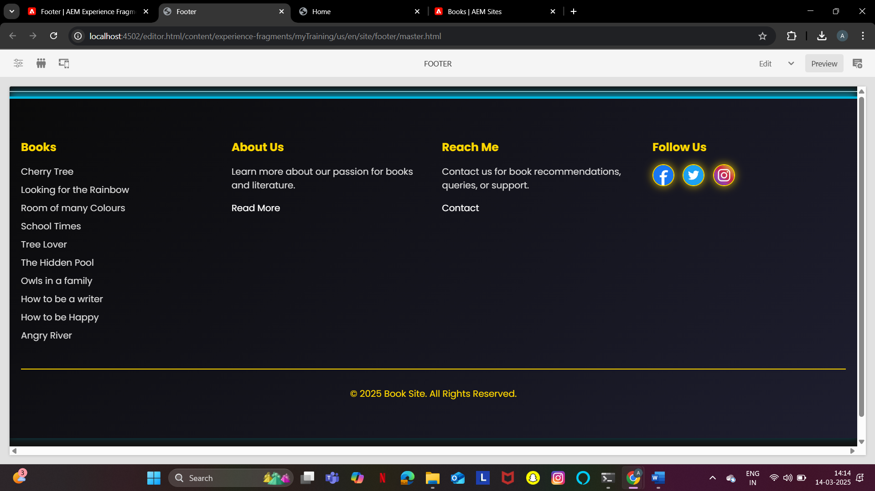
FOOTER
AEM Experience Fragment showcasing the Footer section with categorized content:
Books list featuring popular titles.
About Us section providing information about the site's purpose.
Reach Me section for contact details and queries.
Follow Us section with social media icons for engagement.
A copyright notice at the bottom for legal protection.
Designed to enhance navigation, user engagement, and provide essential site information.

Slide 6
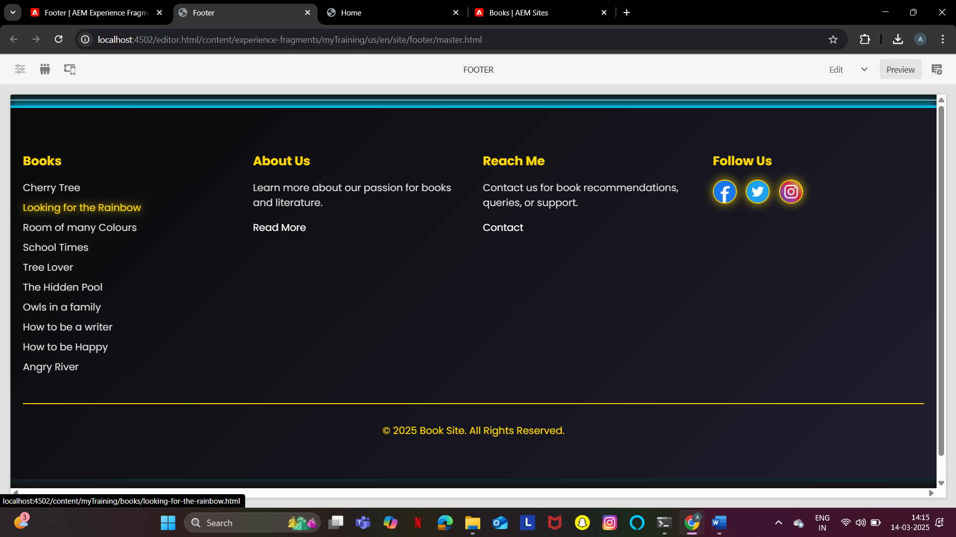
Here if we click the book name it’ll get navigated to the respective book page and the same for the social media icons (Facebook , Instagram and Twitter):

Slide 7
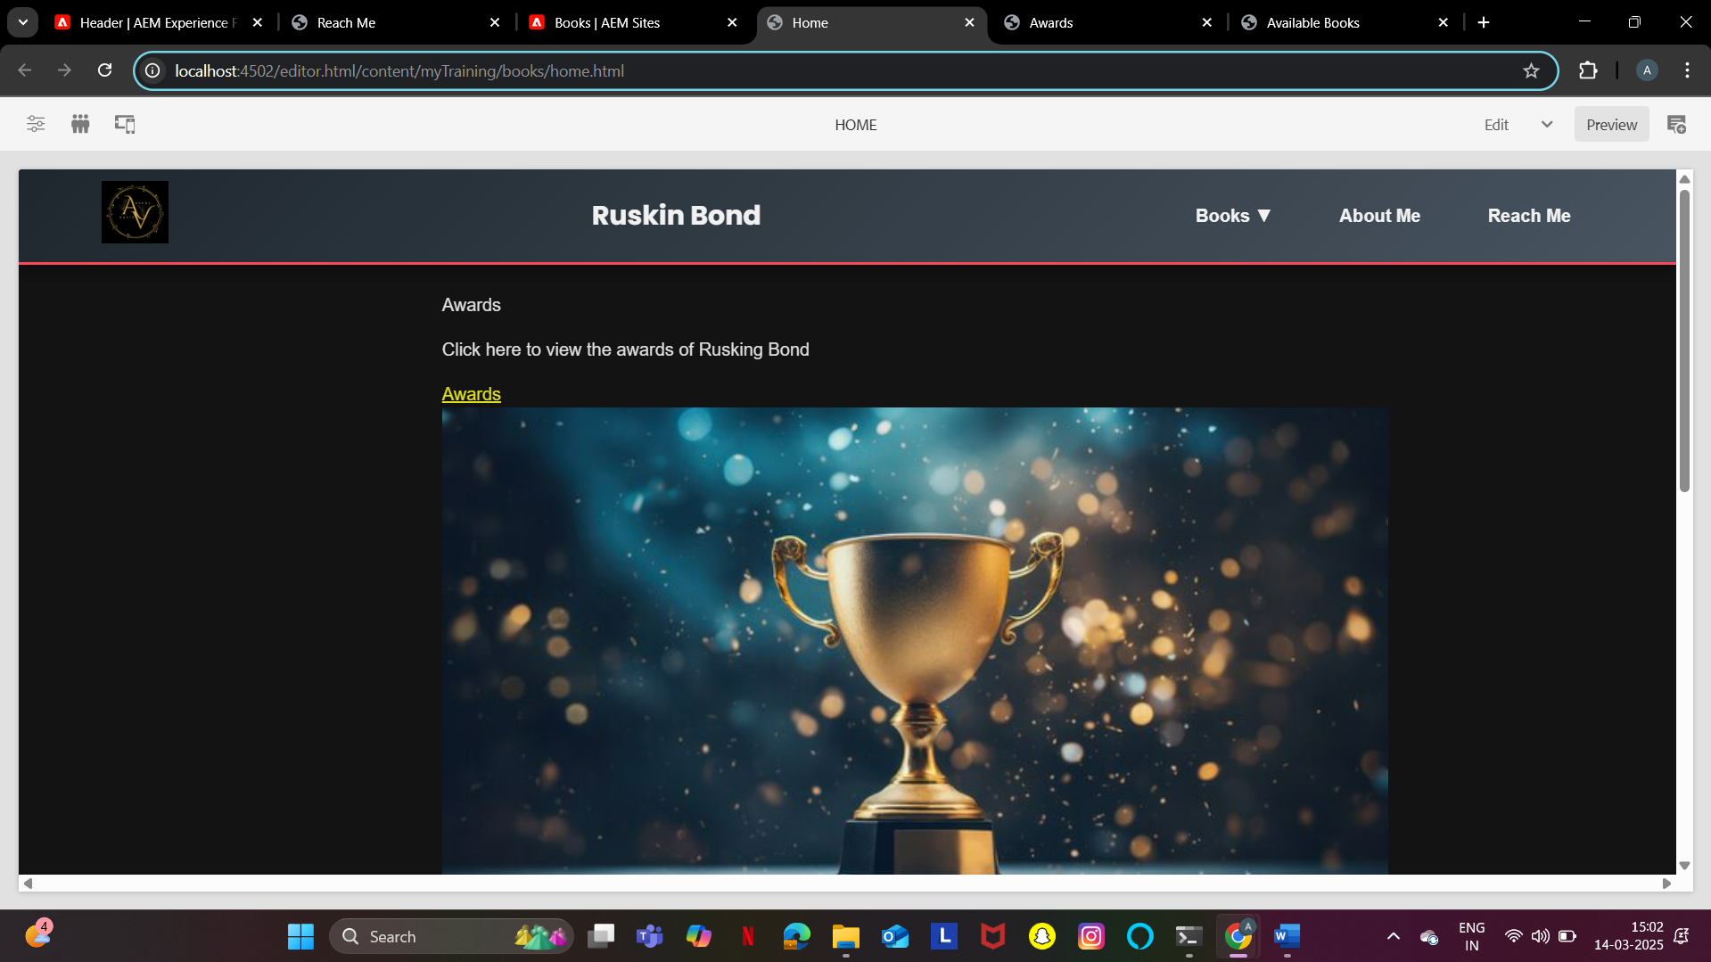
HOME PAGE
AEM page showcasing Ruskin Bond's Awards with a clickable link and an award trophy image for visual appeal.

Slide 8
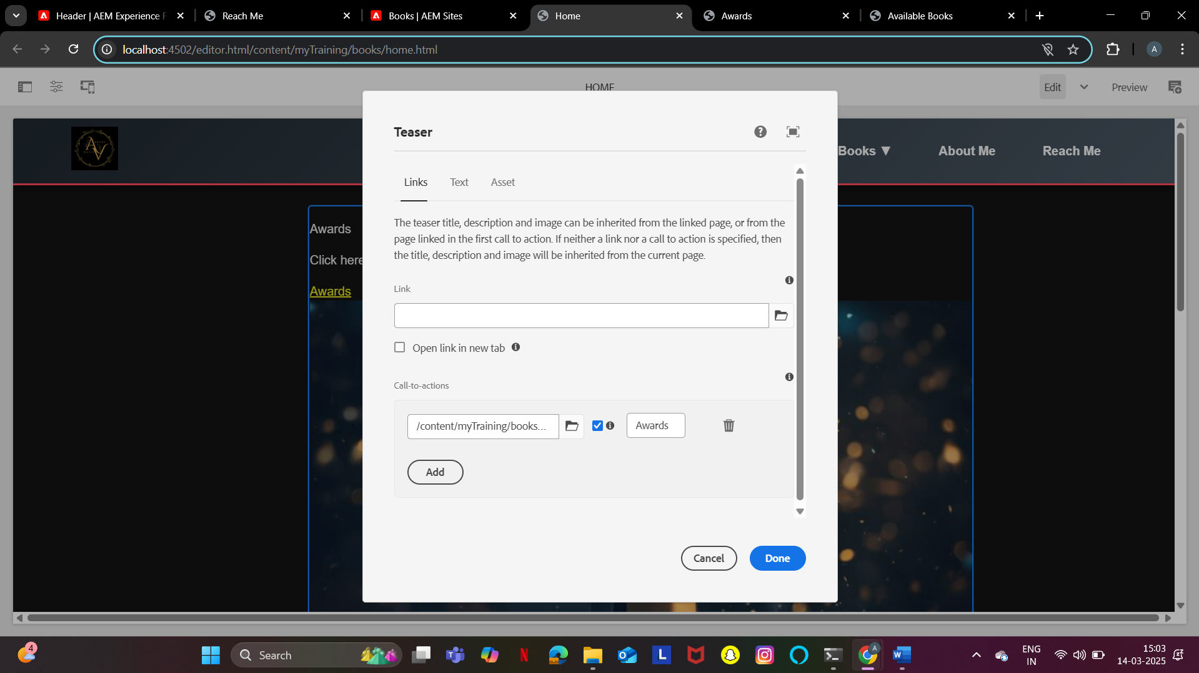
USED TEASER COMPONENT
A Teaser Component in AEM is used to present a combination of image, title, description, and call-to-action (CTA) links to engage users and guide them to other pages or content.
It is commonly used for highlighting key content, such as promotions, featured articles, or navigation links, to improve user interaction and boost content visibility.

Slide 9
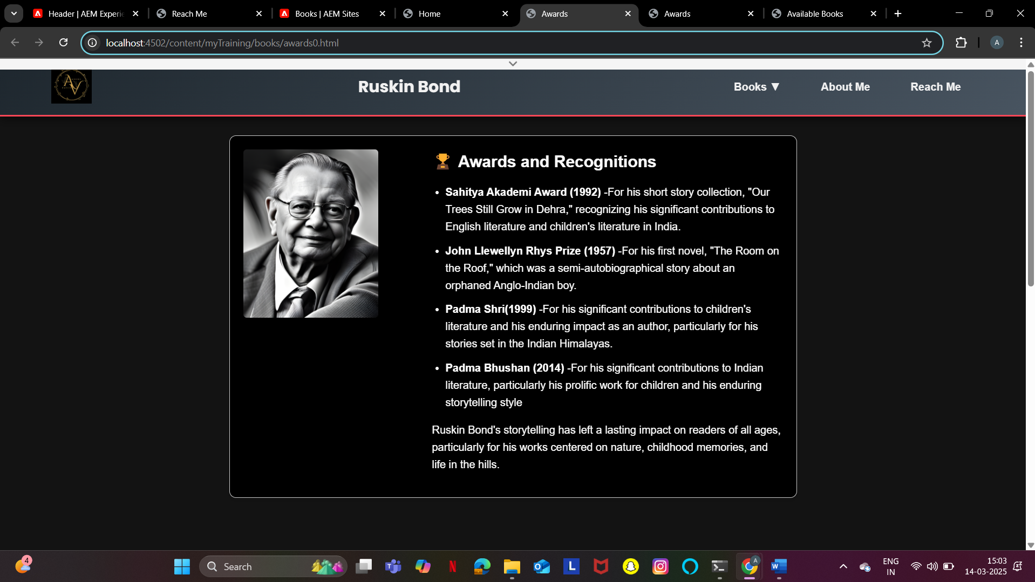

Slide 10
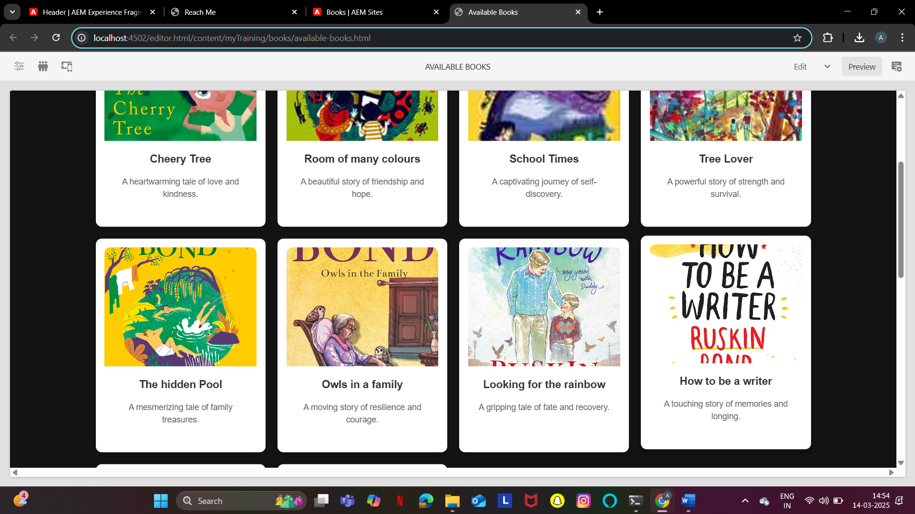
BOOKS PAGE
AVAILABLE BOOKS:

Slide 11
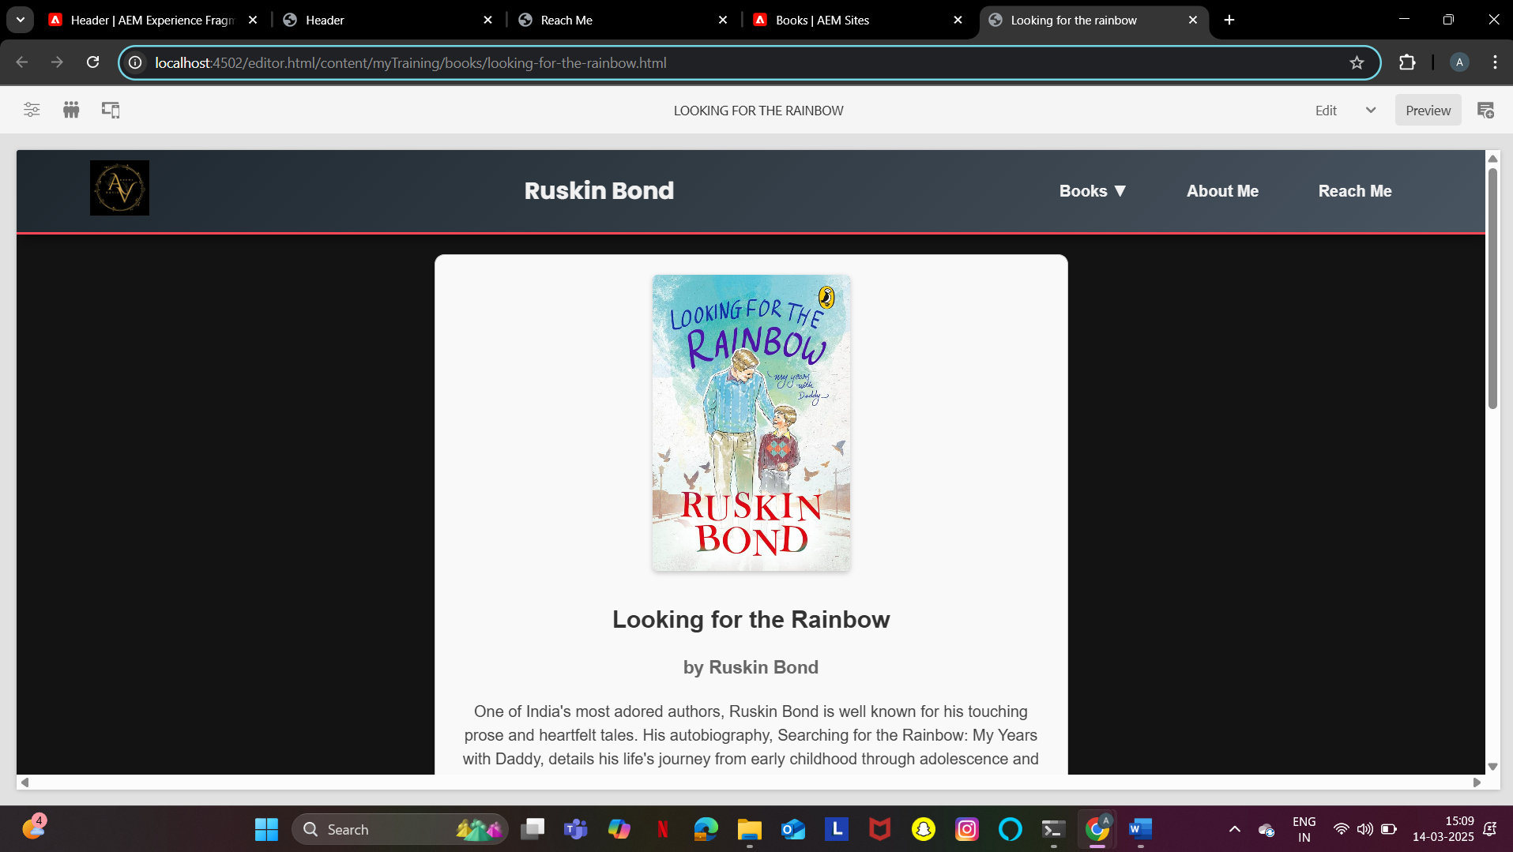
Book Page :
It contains :
Book Name
Author Name
Book Image
Summary

Slide 12
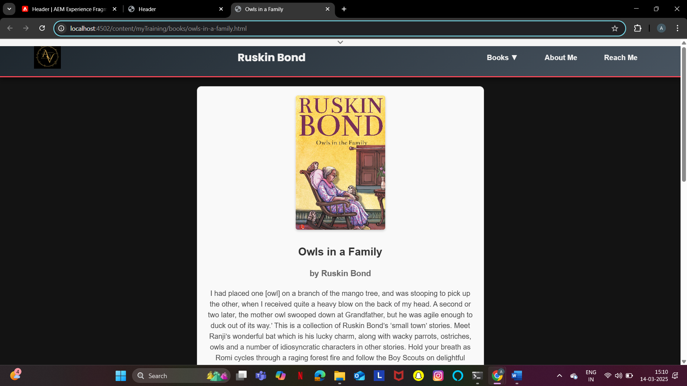

Slide 13
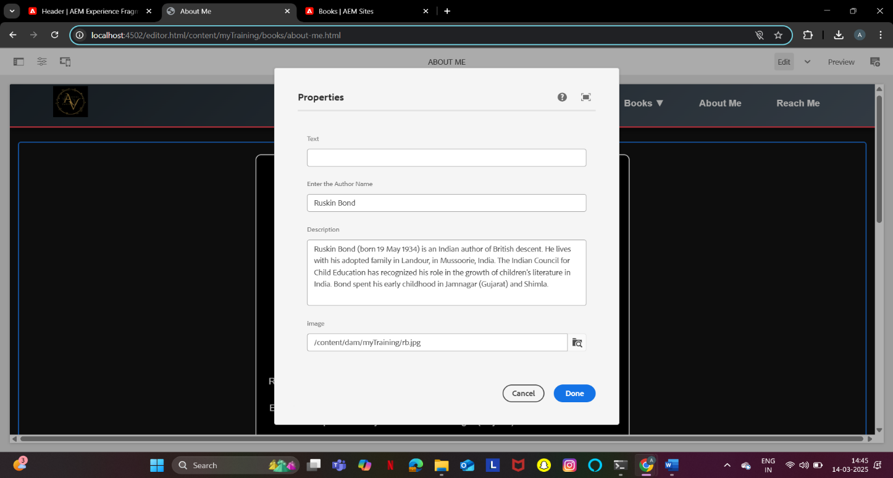
ABOUT ME PAGE
It contains :
Author image
Author name
About the author

Slide 14
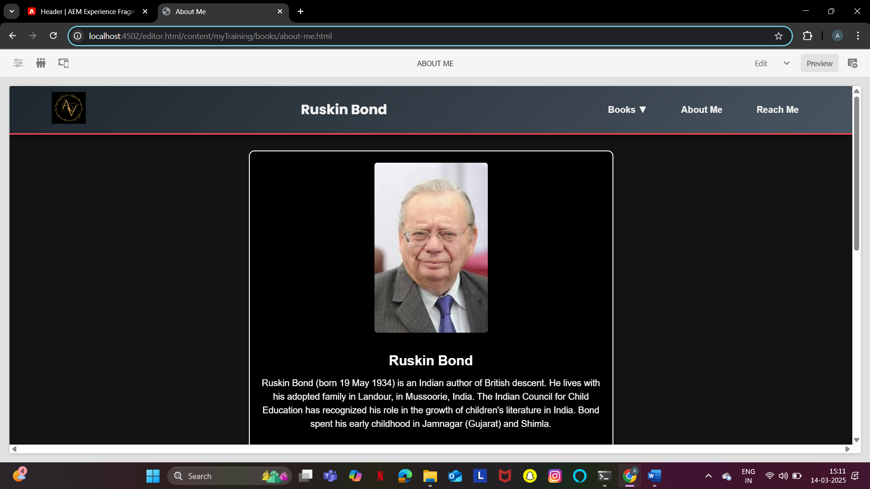

Slide 15
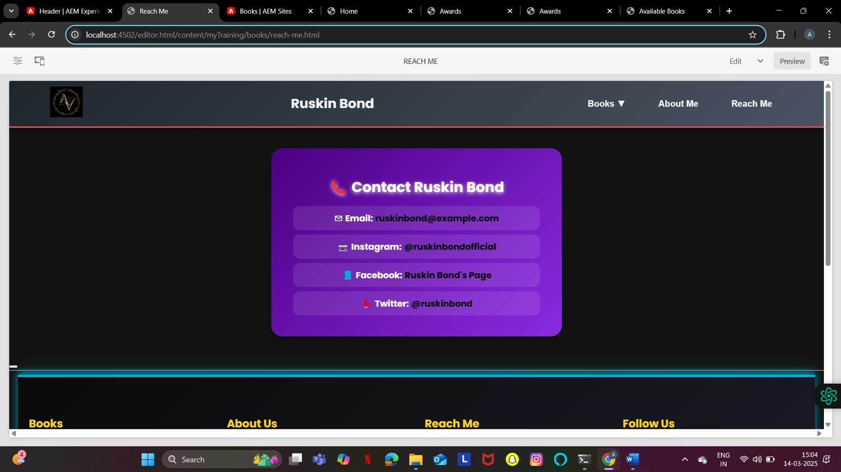
REACH ME PAGE
It contains:
Email
Instagram
Facebook
Twitter

Slide 16
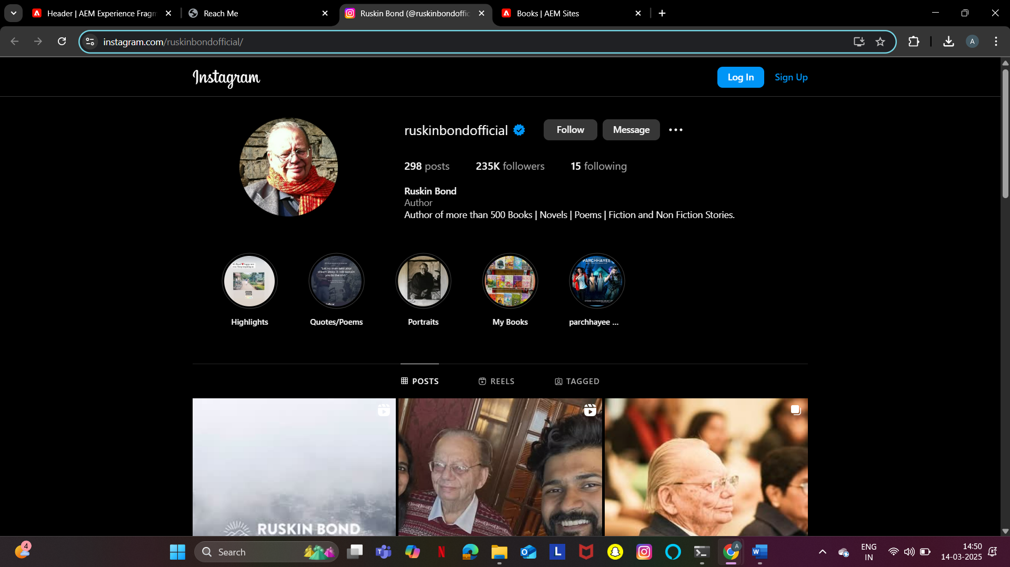
If we click the link , it’ll get navigated to the Instagram page and likewise for other links too:

